Slide 1

Predicting MLB 2017 Regular Season Games
BIA 658 Final Presentation
By Matthew Miller

Slide 2
Background
Major League Baseball is known as the first league to truly embrace the movement towards advanced statistics, or “Sabermetrics”
Goal: To use the run differential between teams to predict outcome of future games.
Run Differential: Sum of differences in runs scored between two teams

Slide 3
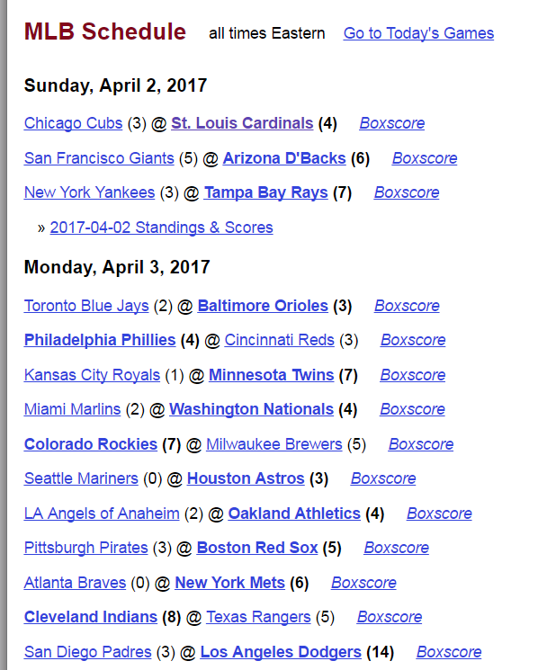
Creating Dataset
Began with getting the final scores of all games of the 2017 MLB Regular Season up to May 31st
Transformed data in Excel to create workable edge list

Slide 4
Creating Dataset
For each game, there were two entries:
Each team acts as team and opponent, and the Run Difference is reversed.

Slide 5
Creating Dataset
The weight between each team was the sum of run differentials between the Team (Source) and Opponent (Target) divided by the total games played between them.
This meant that positive weights meant that the source outscored the target
If an edge exists between two teams, another edge exists in the reverse way with the negative weight

Slide 6
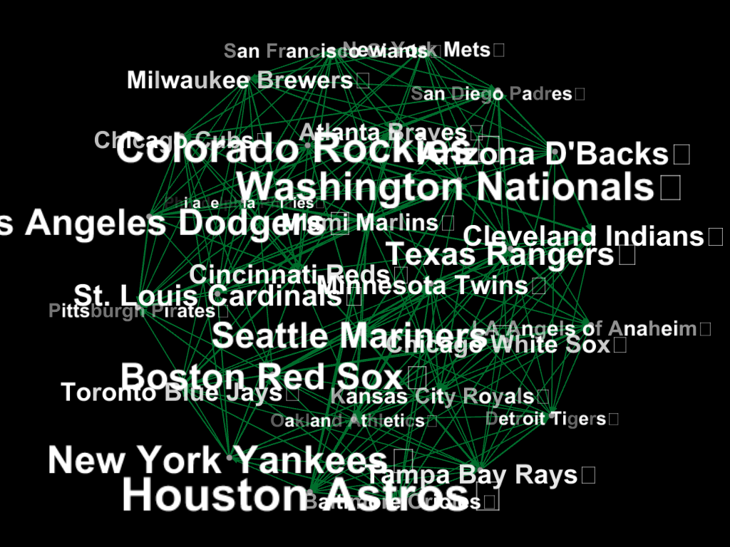
MLB Network
Full Network, with Label Text sized by Out-Degree, only non-negative edges pictured

Slide 7
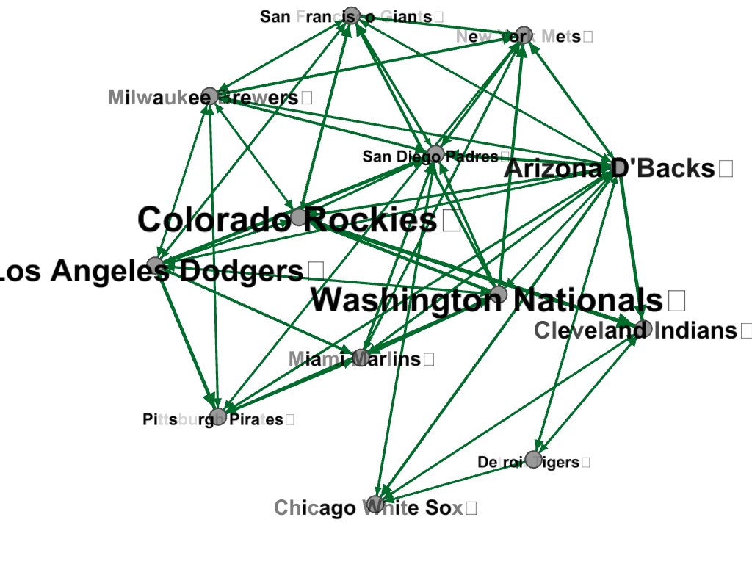
MLB Network
Example Egocentric Network for Arizona D’backs
High In-Degree
=Poorly Performing Team
High Out-Degree
= High Performing Team

Slide 8
MLB Network
30 nodes and 398 edges.
Diameter = 5
Average Path = 2.039
Felt safe moving forward with analysis because of average path.

Slide 9
Analysis
3 Ideas for predicting future run differential:
Comparing Out-Degree: Difference between total run differential for each team
Comparing Total weights to common neighbors – Difference between total run differential when facing same opponents
Comparing Current Edge: Previous matchups between teams.

Slide 10
Analysis
Used games from June 1 to June 21 as values that the data needed to predict.
Ran a univariate linear regression in SAS on predicted run differential using each of the three methods to actual run differential over that time span.
Also looked at how many games would’ve been predicted correctly based on whether the predicted run differential was positive or negative.

Slide 11
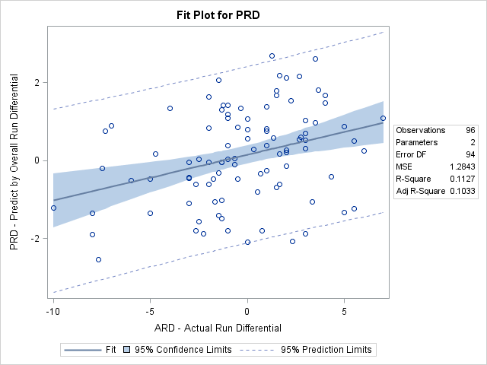
Results
Using Out Degree/Total Run Differential
P Value = .0008
R-squared = .1127
Beta = 0.11806
Games Predicted: 131/258 = 50.78%

Slide 12
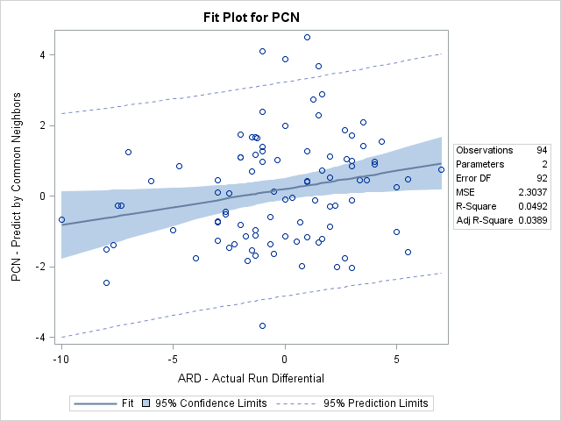
Results
Using Total Weights to Common Neighbors/Results against similar teams
P Value = .0316
R-squared = .0492
Beta = 0.1028
Games Predicted: 126/255= 49.41%

Slide 13
Results
Using Existing Edge/Previous Head to Head Matchups
P Value = .3796
R-squared = .0082
Beta = 0.03812
At this P value, there is not a significant relationship.
Games Predicted: 88/146= 60.27%

Slide 14
Initial Conclusions
There were significant, albeit small, correlations between the actual run differentials and the run differentials predicted by Out Degree and by Edge weights to common neighbors.
However, the existing edge method was best at predicting the results of games at 60%.

Slide 15
Takeaways
Not easy to predict MLB games.
Is Run Differential itself the best statistic to use?
Could combining methods increase the correlation?
Teams change. Could weighting different games based on recency help?

Slide 16
Potential Next Steps
Multiple Linear Regression using the different factors
Problem might occur with multicollinearity
Using other metrics-W/L Ratio, Sabermetrics
Increased weighting towards more recent games played

